Slide 1

Greeneum’s Use of AI Algorithms
By: Alex Goldschmidt

Slide 2

Why does Greeneum make use of AI?
To enable management, smart predictions, optimization, for energy market shareholders.
To monitor and reward those that have succeeded in reducing their respective carbon footprints.
To discover key metrics that drive efficient usage of energy.

Slide 3
Three Types of Algorithms
ARIMA (AutoRegressive Integrated Moving Average) Model
AR (AutoRegressive) Model
OLS (Original Least Squares) Regression Model
VAR (Vector Autoregression) Model

Slide 4
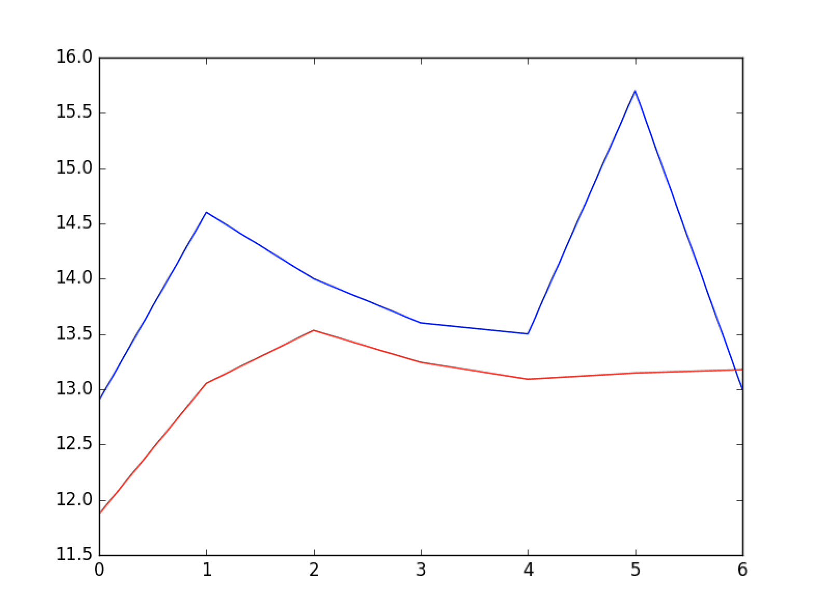
AR Algorithm
A form of linear regression in a current series measured against values calculated previously from the same series.
The value of a predicted variable (Y) calculated using a predictor variable (X) and previous values of Y.
Good for forecasting when there’s a correlation between 2 variables.
Unusable when dealing with nonstationary data.
Fig. 2. Autoregression Model Example: Scientist, David Dalisay Junior Data, and Kevin Beaulieu Software Engineer. “Machine Learning Mastery.” Machine Learning Mastery, 25 Oct. 2021, https://machinelearningmastery.com/.

Slide 5
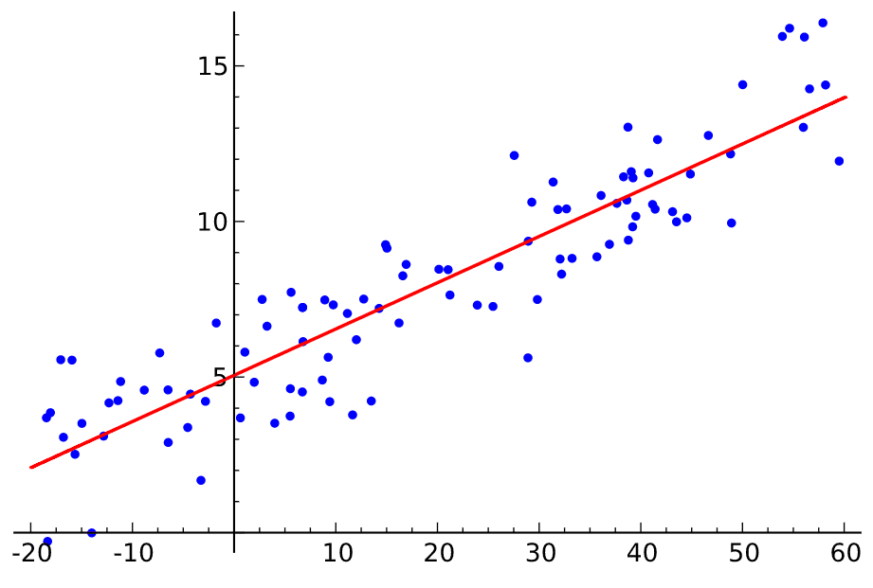
OLS Algorithm
Simple Linear Regression
Algorithm that seeks to show a relationship between a predictor variable (X) and a output variable (Y).
Unusable when the number of parameters to estimate outnumbers the amount of previous observations.
Fig. 3. OLS Model Example: Taylor, Courtney. “OLS Regression Line.” What Is a Least Squares Line?, 17 Jan. 2019, https://www.thoughtco.com/thmb/20AuhtqJpSWY4Xl1rsrN5D_ln48=/921x621/filters:fill(auto,1)/regression-5aaf9c73a18d9e003792a8ab.png. Accessed 15 June 2022.

Slide 6
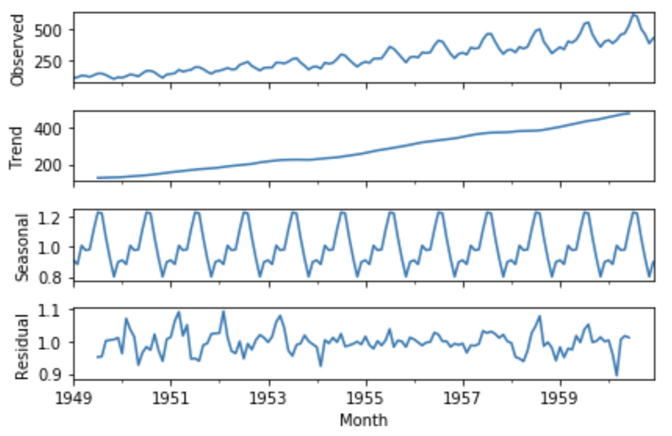
ARIMA Algorithm
Class of models that make forecast of time series data based on lag values and lagged forecast errors.
Lag value: Constant or a weighted sum of one or more recent values of Y.
Lagged Forecast Error: Weighted sum of errors within a forecast.
Unusable when there is no time series data to work with.
Fig. 1. ARIMA Model Example: Shawl, Sami. “ARIMA Model Example.” GeeksforGeeks, 19 Feb. 2020, https://www.geeksforgeeks.org/python-arima-model-for-time-series-forecasting/. Accessed 15 June 2022.

Slide 7
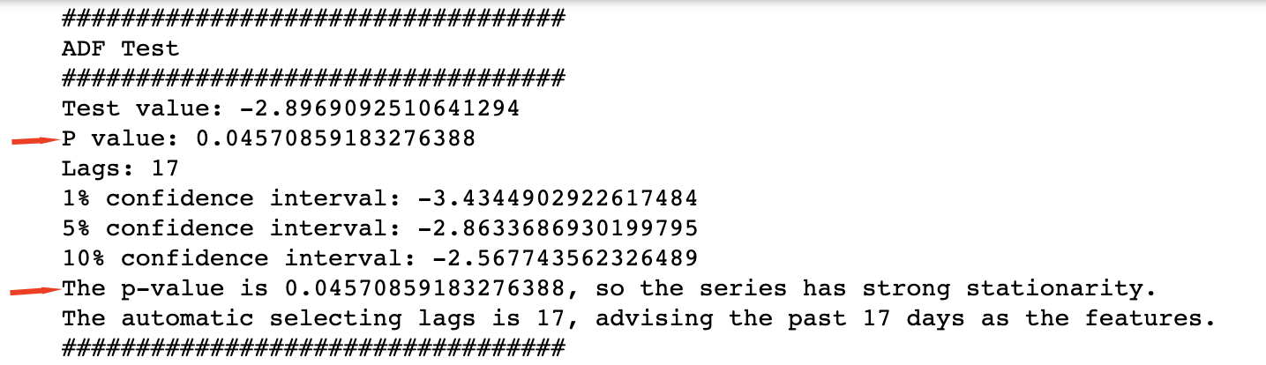
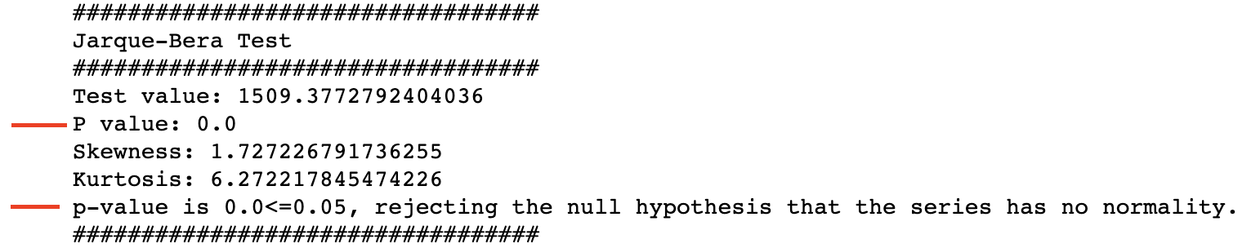
ARIMA with CEEMDAN LSTM of Carbon Price Example
Check if data is stationary using Augmented Dickey Fuller Test.
Check if data has normality using Jarque-Bera Test.

Slide 8
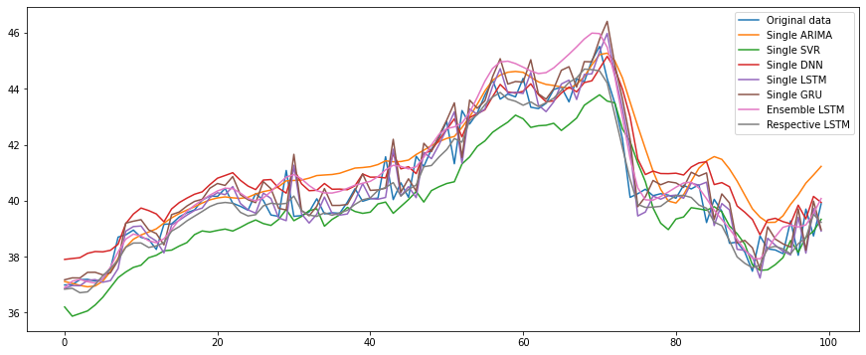
ARIMA with CEEMDAN LSTM of Carbon Price Example
The goal here is to predict Carbon Price based on data provided.
Comparison of price predictions by different algorithms (including ARIMA) and original data.
Use of ARIMA algorithm in this case yields highest prediction of carbon price at the right end of the graph.

Slide 9
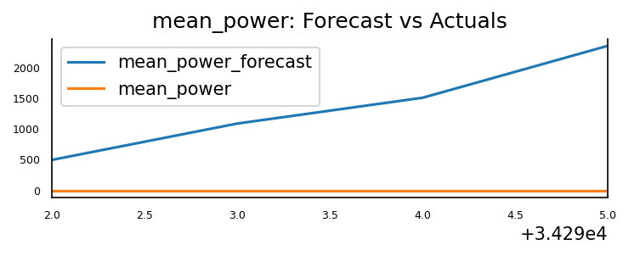
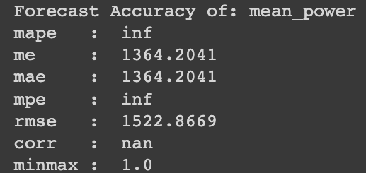
VAR Algorithm
Multivariate forecasting algorithm that is used when 2 or more time series influence each other.
VAR becomes unusable when variables in a time series are not stationary and are not cointegrated.
Cointegration: variables have long-term relationship.

Slide 10
RMSE in each model
Root Mean Squared Error
Metric that tells us the average distance between the predicted values of a model and the actual values of a given dataset.
The lower the score, the better a RMSE is in fitting a given dataset

Slide 11
Complexity, Use Cases, Running Time
ARIMA, AR, and VAR takes longer to compute as the amount of inputs within the model grow (linear time complexity); demand forecasting, securities prices, growth of wages ,etc.
OLS takes the same amount of time to compute regardless of amount of inputs; anything that indicates a relationship between 2 things.

Slide 12
Thank You

Slide 13
References
https://www.statisticshowto.com/autoregressive-model/
https://people.duke.edu/~rnau/411arim.htm
https://medium.com/analytics-vidhya/arima-for-dummies-ba761d59a051
https://www.geeksforgeeks.org/python-arima-model-for-time-series-forecasting/
https://otexts.com/fpp2/AR.html

